Slide 1
Cognitive Status Implementation Guide for STU1 Ballot
Caleb Wan, MITRE PACIO Project
calebwan@mitre.org
6/23/2020

Slide 2
Agenda
Overview of Cognitive Status IG for STU1
Using the IG Profiles and Examples
IG Issues and Proposed Resolutions
Remaining Work before Bullet

Slide 3
Overview of Cognitive Status IG for STU1

Slide 4
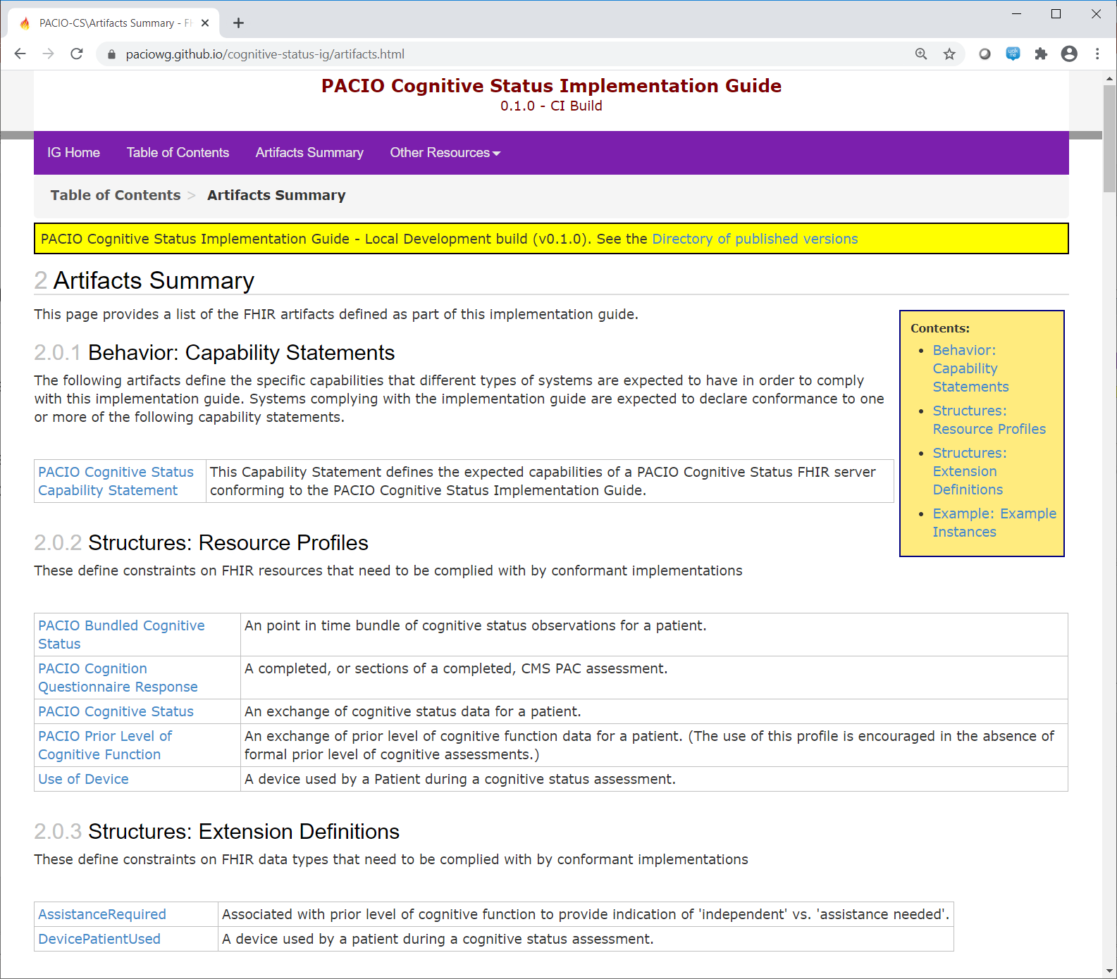
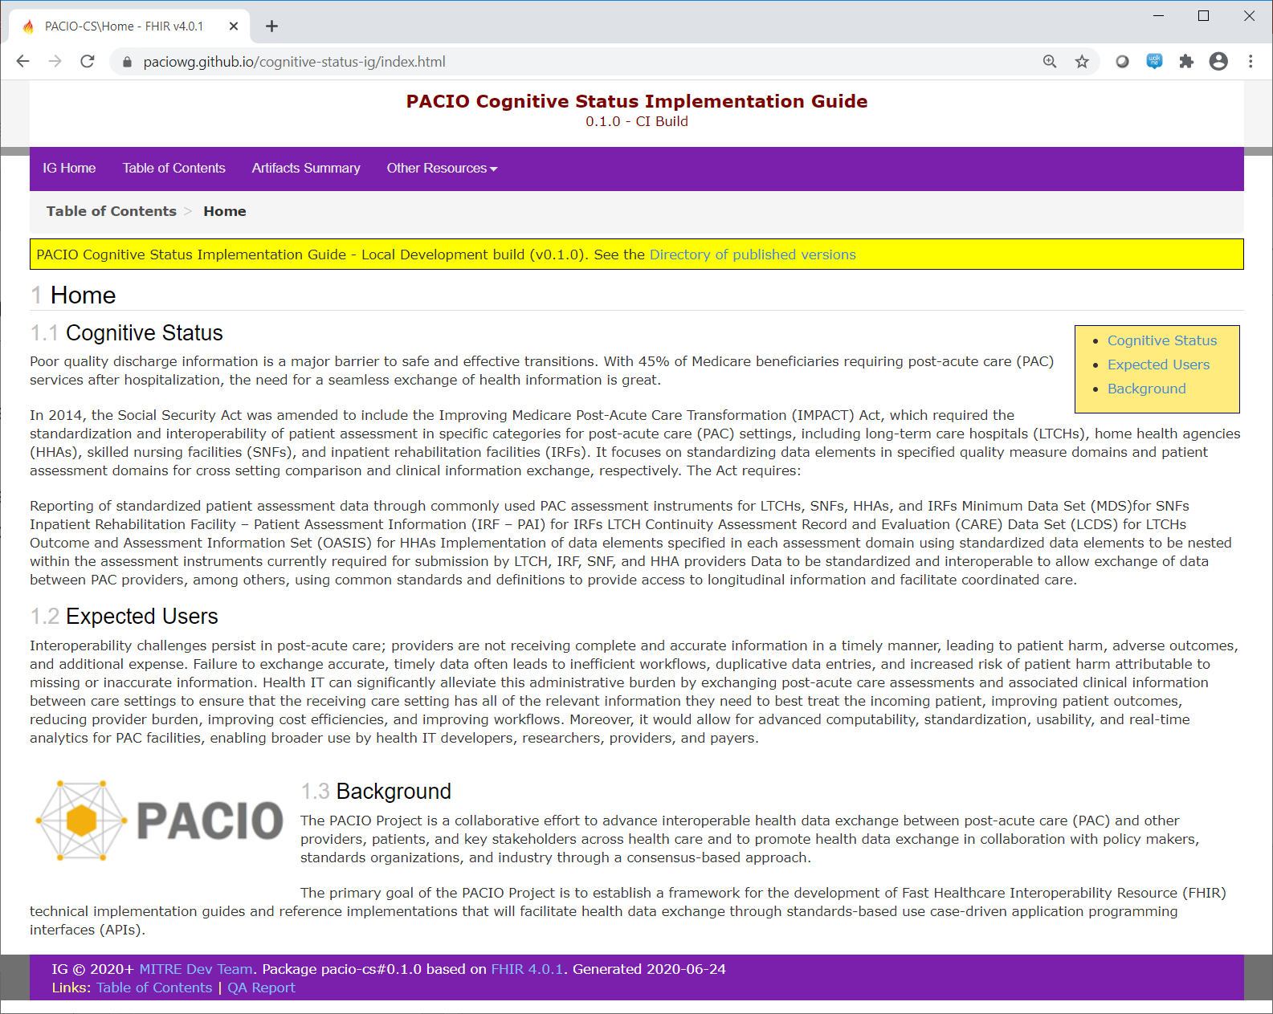
Implementation Guide Overview

Slide 5
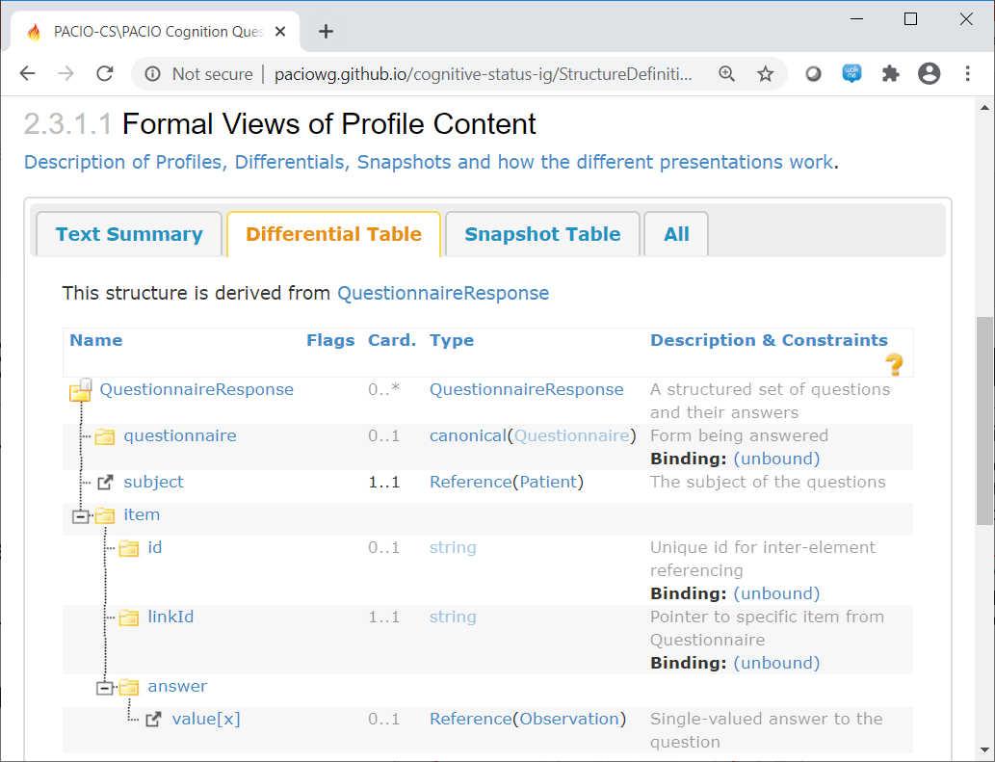
IG Profile: CognitionQuestionnaireResponse
Derived from resource QuestionnaireResponse
‘subject’ field is required and constrained to a reference to Patient
‘item.id’ field is used to hold the LONIC code of the question
‘item.linkId’ field should contain the ‘linkId’ of the corresponding section title or question from the Questionnaire
‘answer’ field is constrained to a reference to Observation

Slide 6
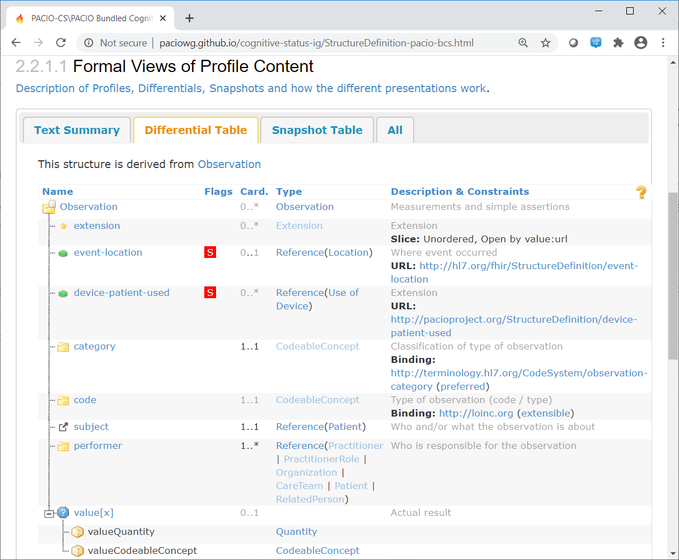
IG Profile: BundledCognitiveStatus
Derived from resource Observation
Intended to hold a point in time bundle of cognitive status observations
Added ‘must support’ extensions: event-location and device-patient-used
‘category’ field is required and should contain the value ‘survey’ for PAC assessment
‘code’ field requires a LOINC code but is extensible
‘subject’ field is required and constrained to a reference to Patient
At least one ‘performer’ is required
‘value’ field can only be of the type Quantity or CodeableConcept
‘hasMember’ field points to an observation instance
‘derivedFrom’ field points to a Questionnaire Response instance

Slide 7
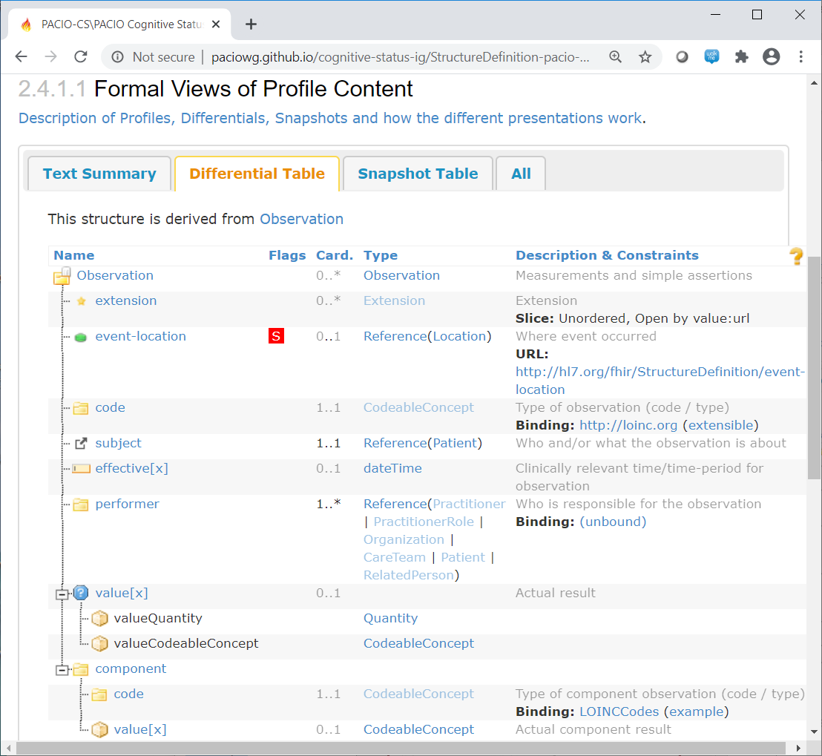
IG Profile: CognitiveStatus
Derived from resource Observation
Intended to hold a cognitive status observation
Added ‘must support’ extension: event-location
‘code’ field requires a LOINC code but is extensible
‘subject’ field is required and constrained to a reference to Patient
‘effective’ field is limited to the type dateTime only
At least one ‘performer’ is required
‘value’ field can only be of the type Quantity or CodeableConcept
‘component.code’ contains the LOINC code or text of the column header if it is used
‘component.value’ contains the corresponding answer for the question
‘derivedFrom’ field points to a Questionnaire Response instance

Slide 8
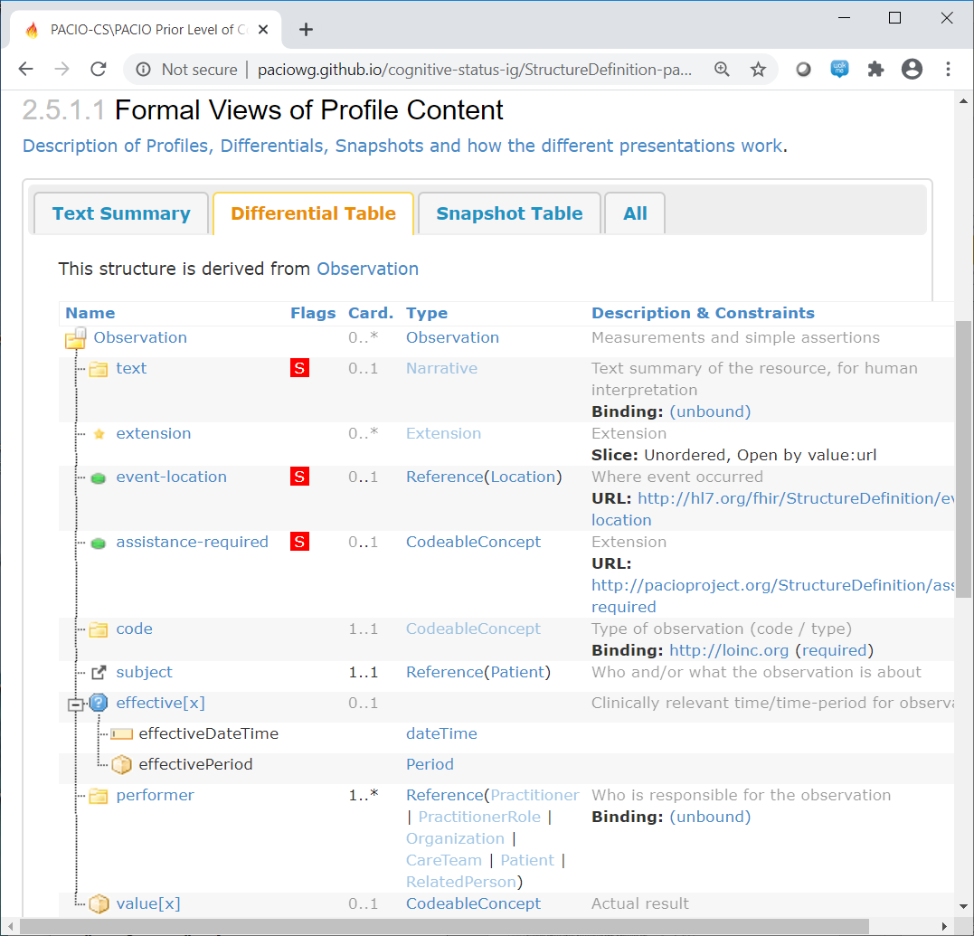
IG Profile: PriorLevelOfCognitiveFunction
Derived from resource Observation
Intended to hold prior level of cognitive function data when formal prior level of cognitive assessments are not available
Added ‘must support’ extensions: event-location and assistance-required
‘text’ field is designated as ‘must support’ and to be used as text summary of the prior level of cognitive function for the patient
‘code’ field requires a LOINC code
‘subject’ field is required and constrained to a reference to Patient
‘effective’ field is limited to the type dateTime or Period
At least one ‘performer’ is required
‘value’ field can only be of the type CodeableConcept

Slide 9
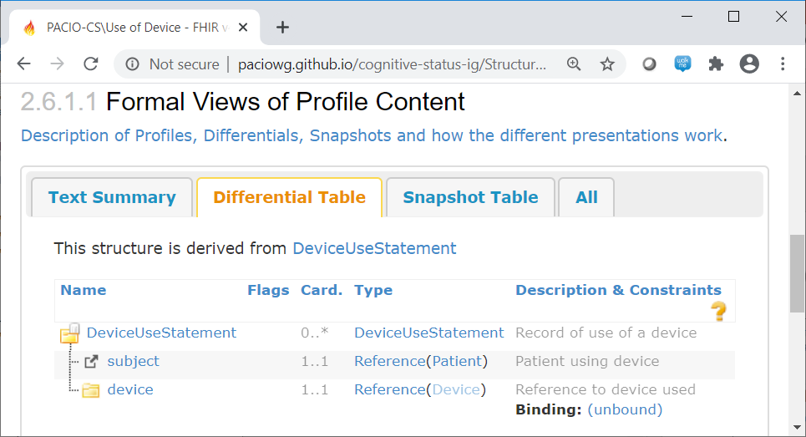
IG Profile: UseOfDevice
Derived from resource DeviceUseStatement
Indicates a device used by a patient during a cognitive status assessment
‘subject’ field is required and constrained to a reference to Patient
‘device’ field is required

Slide 10
Using the IG Profiles and Examples

Slide 11
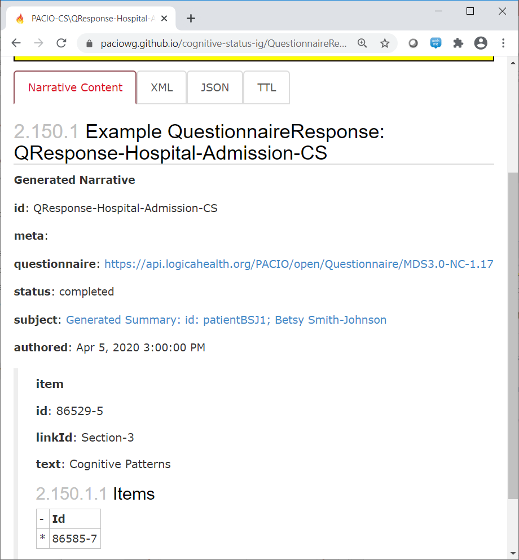
CognitionQuestionnaireResponse Example
The ‘questionnaire’ is the URL to the questionnaire file.
Use ‘id’ to hold the LOINC of the heading or question.
Should have the same nesting structure as showed in Questionnaire.
The linkId’s should match those showed in Questionnaire.

Slide 12
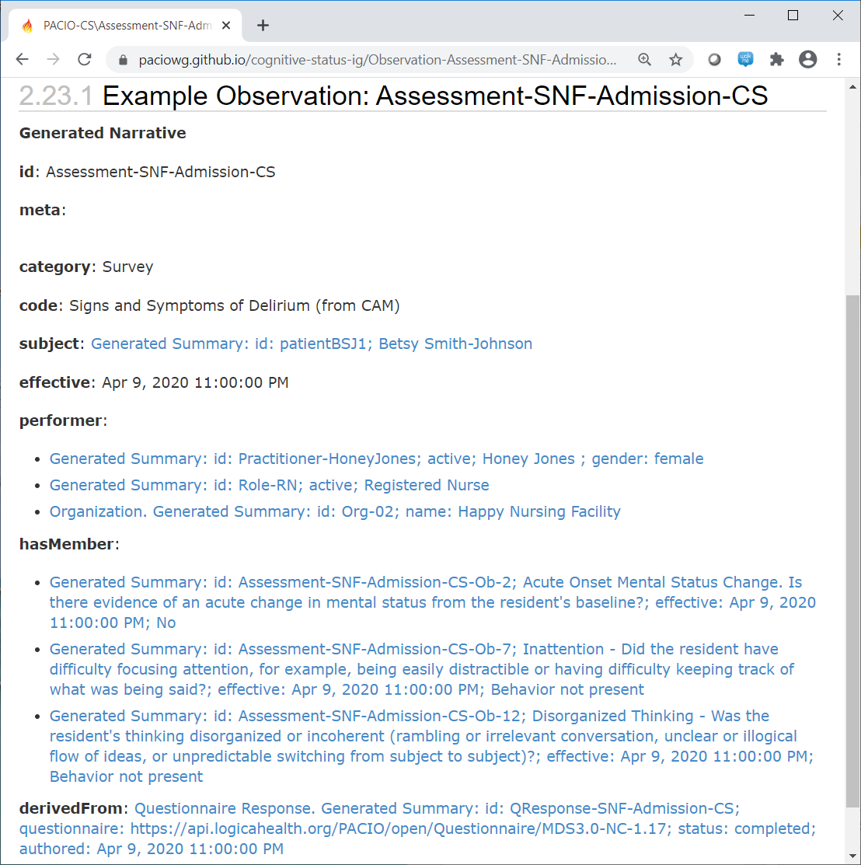
BundledCognitiveStatus – CAM Example
Here is how the ‘event-location’ extension is used to point to a location resource.
Make sure the right LOINC is used.
Use ‘survey’ for category for PAC assessment.

Slide 13
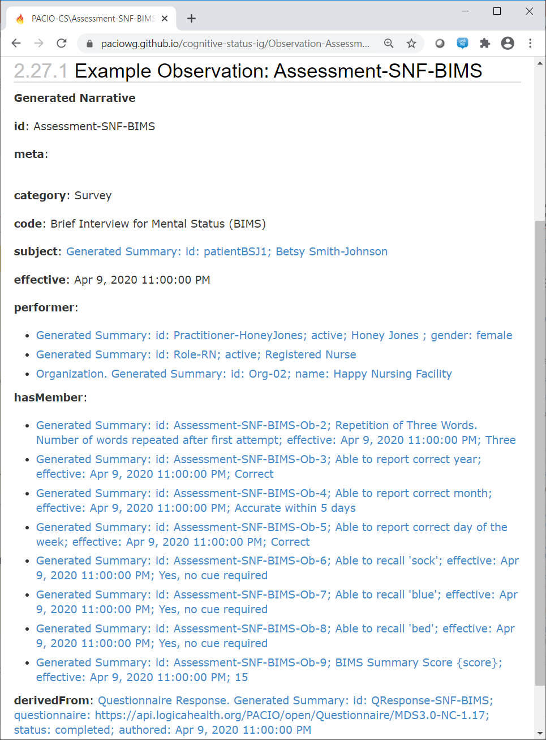
BundledCognitiveStatus – BIMS Example
Make sure the right LOINC is used.
Use multiple ‘performer’ fields to indicate Practitioner, PractitionerRole, and Organization.

Slide 14
IG Issues and Proposed Resolutions

Slide 15
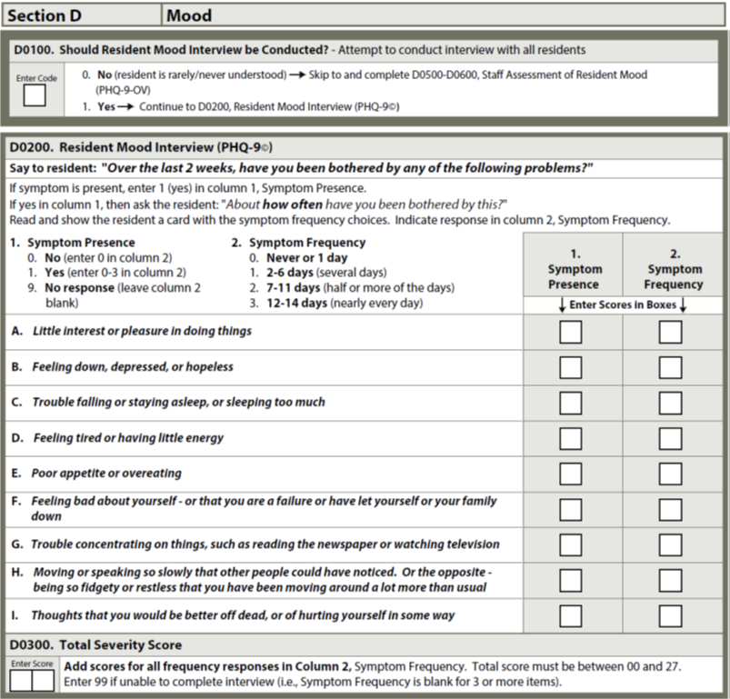
Two-Column Display as in PHQ-9
The PHQ-9 assessment contains two sets of the same questions under different grouping names
However, the PHQ-9 section in the Questionnaire does not show this explicit structure of one set of questions under one grouping name

Slide 16
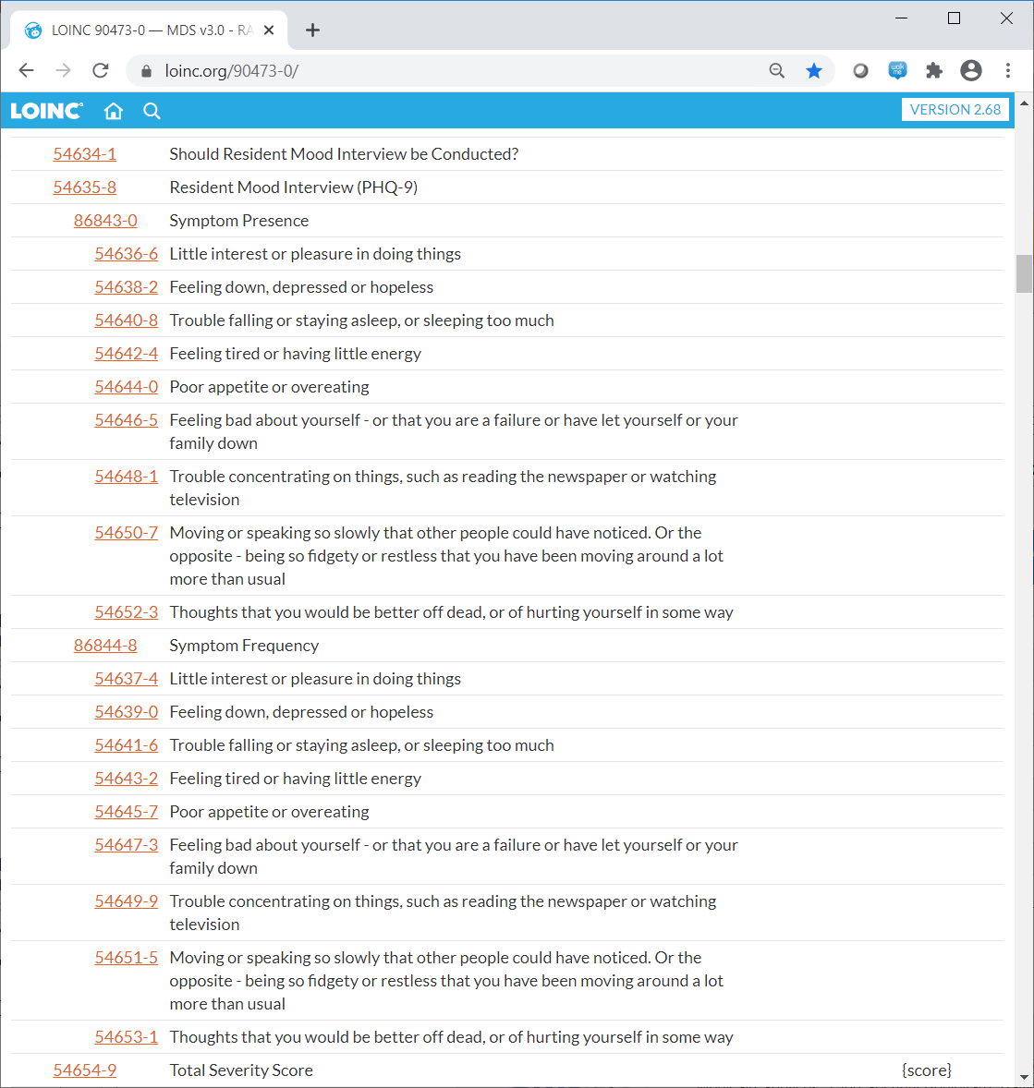
Two-Column Display as in PHQ-9
In contrast, the LOINC codes for the PHQ-9 do provide explicit nesting structure
There are LOINC codes for the grouping names ‘Symptom Presence’ and ‘Symptom Frequency’

Slide 17
Two-Column Display as in PHQ-9
For the CognitionQuestionnaireResponse resource we have chosen to follow the LOINC code nesting structure and add an extra explicit nesting structure to PHQ-9 QuestionnaireResponse resource instances
Questions under one heading

Slide 18
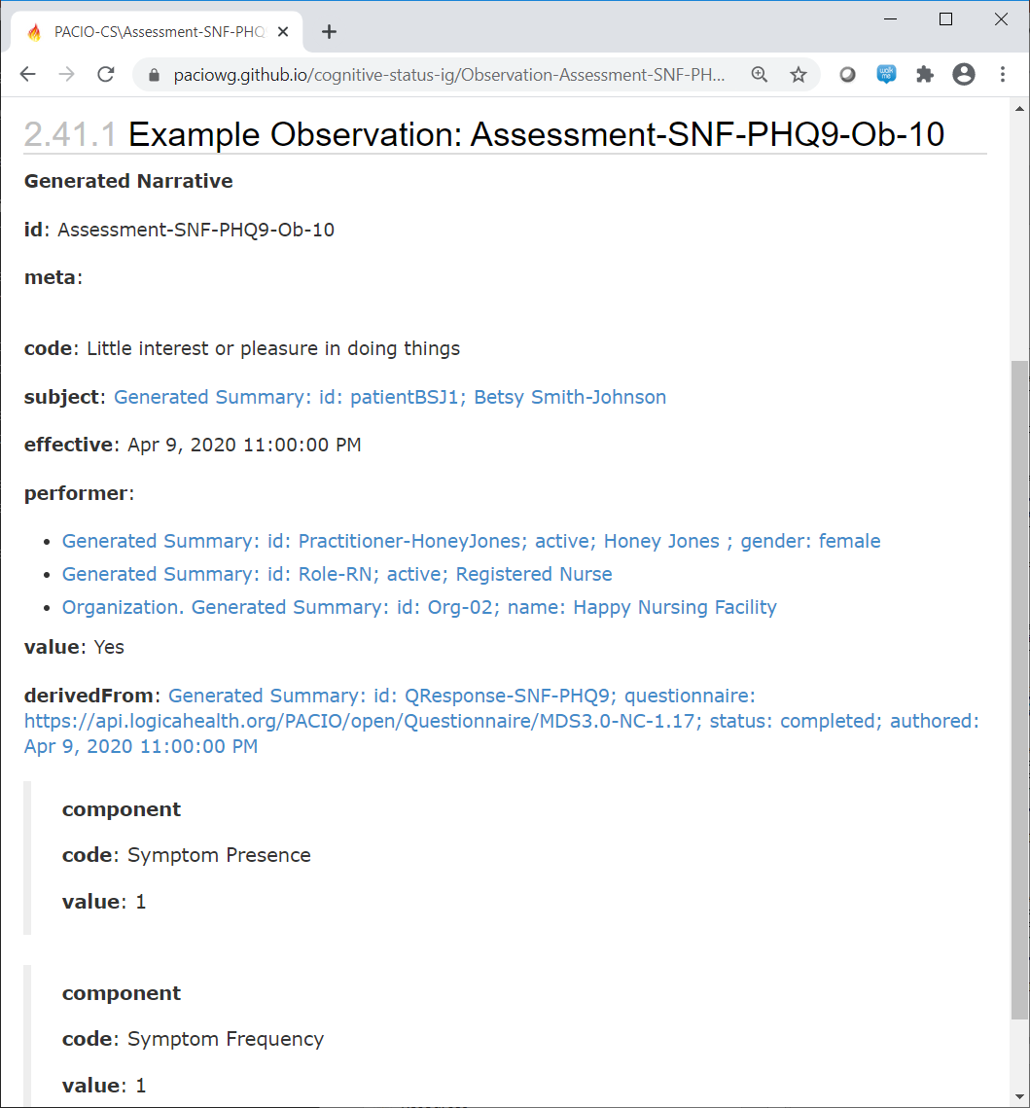
Two-Column Display as in PHQ-9
Furthermore, for the CognitiveStatus resource we have considered the use of the ‘component’ field to show answers to corresponding associated questions (columns)
This will facilitate the grouping of answers/questions in support of side-by-side display
Use ‘component’ only when we want to add support for side-by-side display

Slide 19
PriorLevelOfCognitiveFunction
LOINC code is required when an instance of this IG profile resource is constructed
The only suitable LOINC code we are aware of is LP74248-3 (https://loinc.org/loinc/LP74248-3/) with display name ‘Prior level of function’
This LOINC code LP74248-3 will be used for the PriorLevelOfFunction profile from the Functional Status IG
Should the Cognitive Status IG also adopt LP74248-3 to be used for the PriorLevelOfCognitiveFunction profile?

Slide 20
Remaining Work before Bullet

Slide 21
Remaining Work
Update the IG home page to contain more contents including ‘how to’ and other helpful sections
Update the Capability Statement to reflect the latest changes to the IG
Construct a fuller set of profile sample data conforming to the IG for STU1 bullet

Slide 22
Resources
PACIO Cognitive Status
Implementation Guide: https://paciowg.github.io/cognitive-status-ig/
Cognitive Status Sample Data: https://paciowg.github.io/cognitive-status-ig/artifacts.html
Hosted Reference Implementations
Server: http://hapi.fhir.org/baseR4
Client: https://snf-transfer-summary.herokuapp.com/
Reference Implementation Code (Apache 2.0 license)
Server: https://github.com/jamesagnew/hapi-fhir
Client: https://github.com/paciowg/transfer-summary-ri-client

